Slide 1
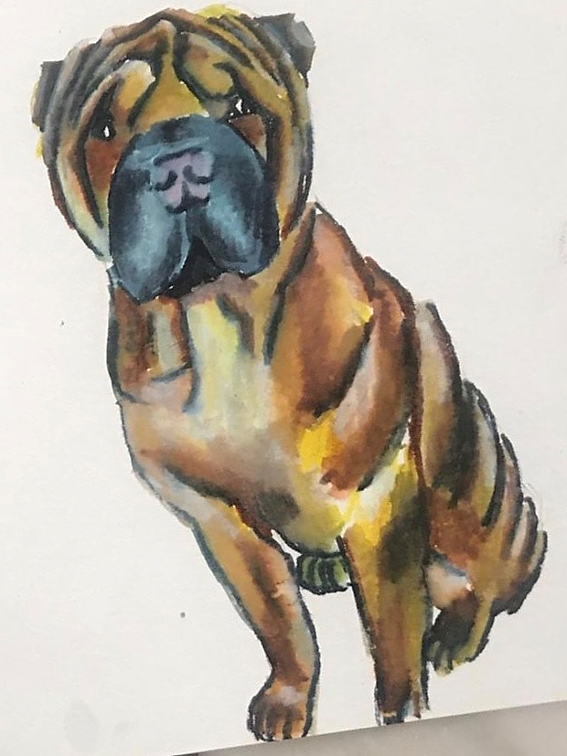
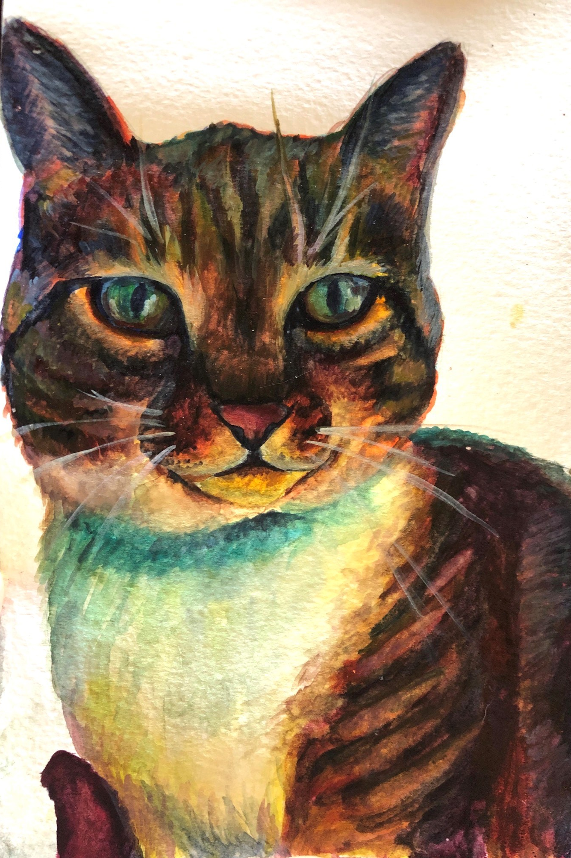
Pets by Kelsey
I have been painting friends’ pets, because it is much more fun that way! I am toying with the idea of starting a small side business for them, charging a small price just to cover the shipping costs.
Any animal works!
If anyone at the OIE would like a pet painting, you are more than welcome to contact me.
Kelsey Galantich
Intern, Veterinary Legislation Support Programme
k.galantich@oie.int
Mob. +267 74 121 252
WhatsApp +1 (757 )814-0704
Jorge’s dog Sebastiao

