Slide 1





The Amicale’s top pick of
Holiday activities

Slide 2
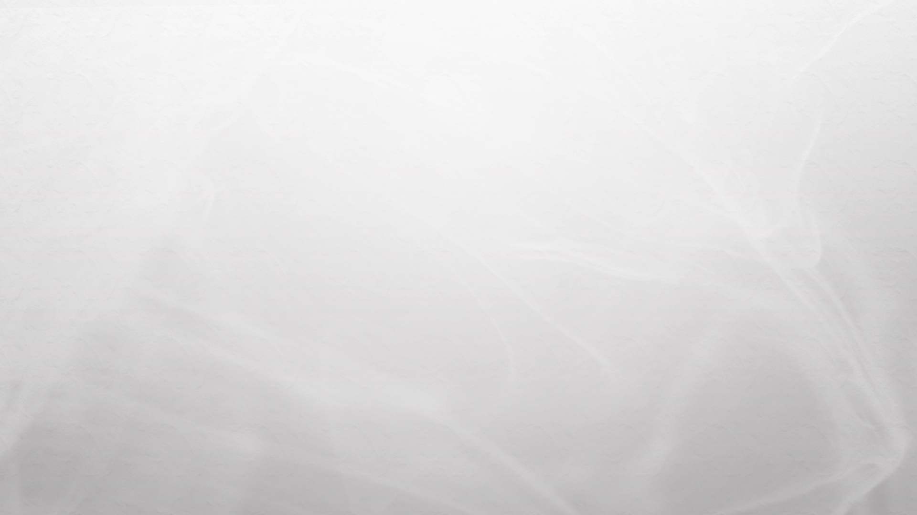
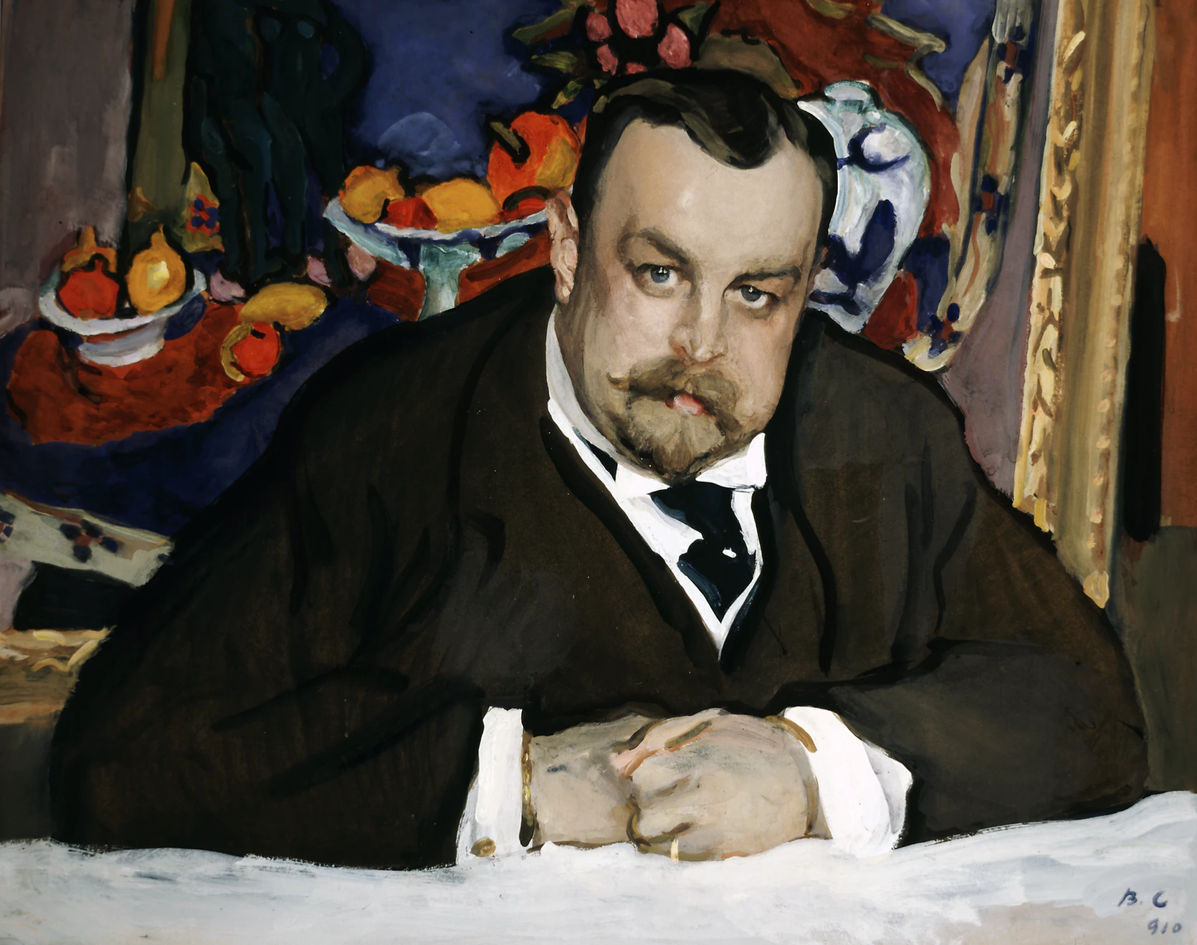
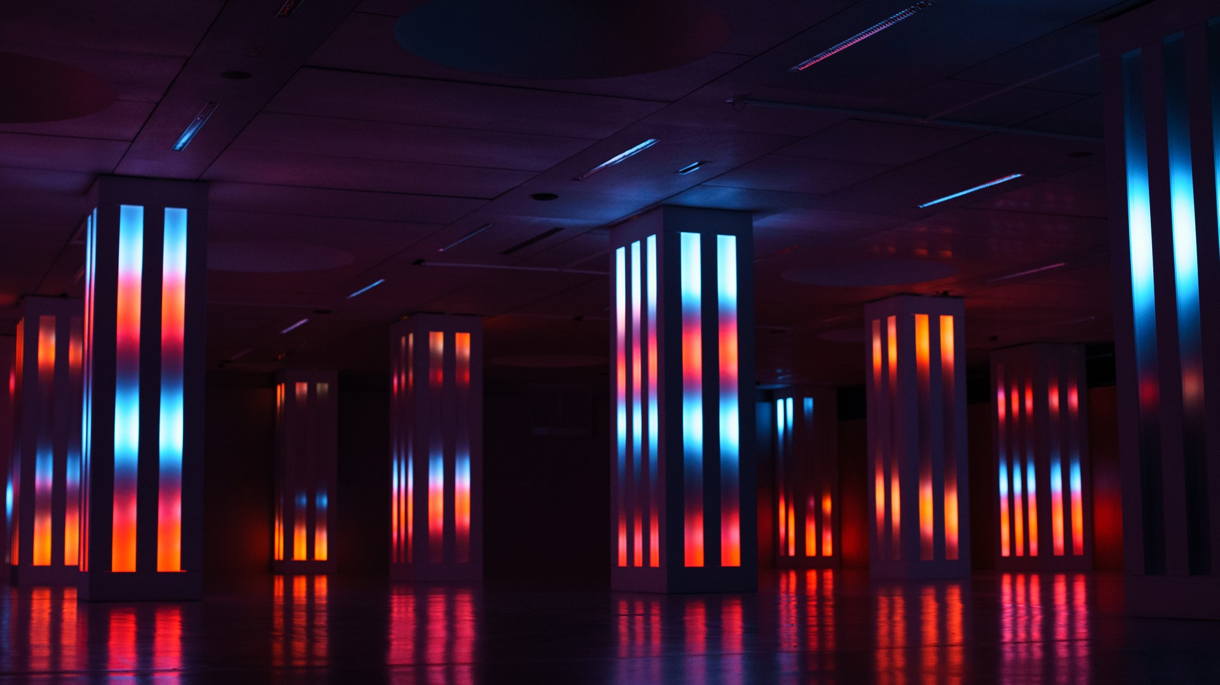
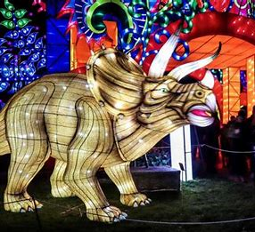
OUTDOOR ACTIVITIES
until 22 February 2022, YOU CAN SEE The Morozov Collection, one of the world’s GREATEST collections of Impressionist and Modern art, at the Fondation Louis Vuitton. This is the first time the collection has traveled outside of Russia.
Until 6 March 2022, you can see Détour – Visual System, an immersive audiovisual sculpture, at La Gaité Lyrique for free.
You can also visit the exhibition illuminated evolution at Jardin des Plantes until 30 January 2022.

Slide 3
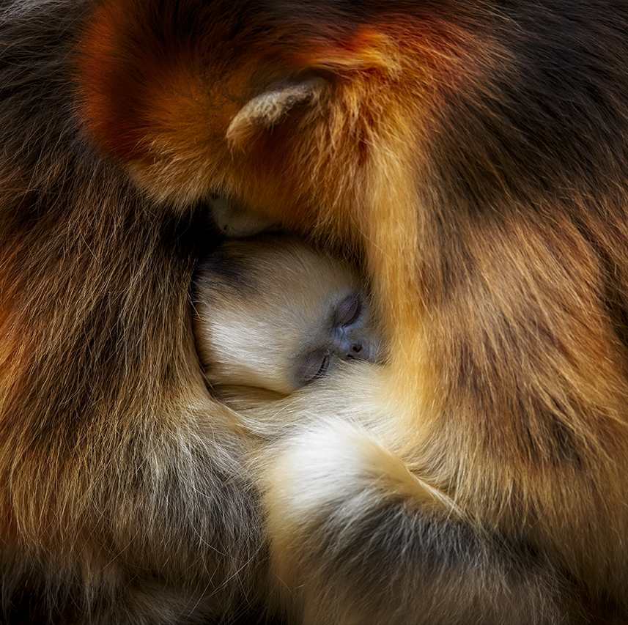
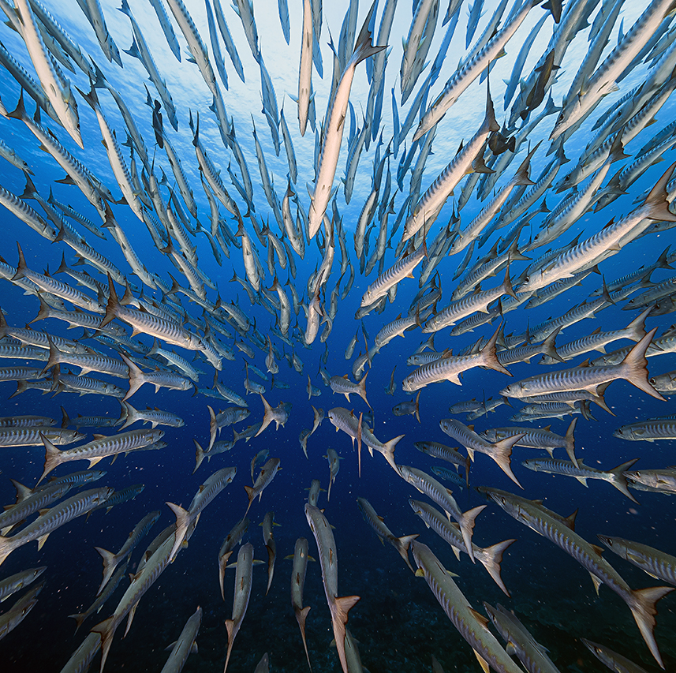
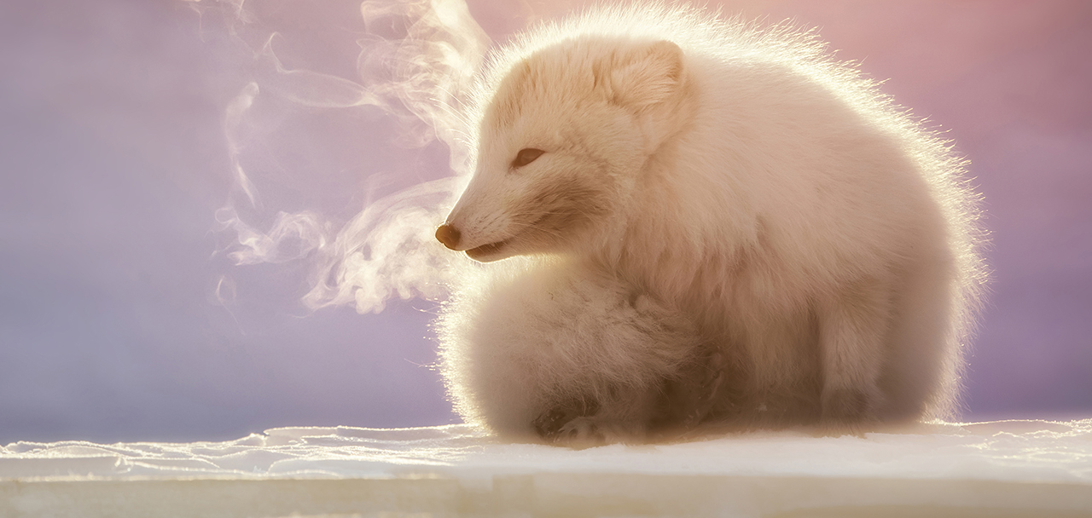
WILDLIFE PHOTOGRAPHER OF THE YEAR
You can vote for wildlife photographer of the year for the people’s choice award until 2 February 2022. you can see the amazing photographs here: https://www.nhm.ac.uk/wpy/peoples-choice

Slide 4
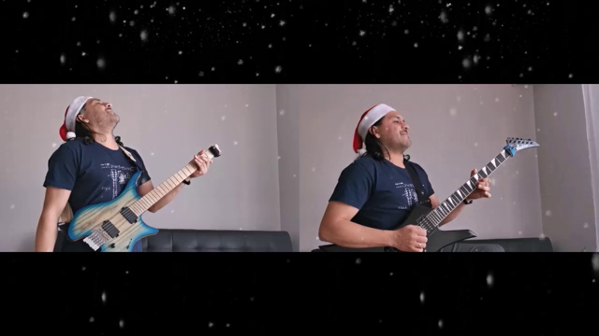
Happy Holidays!
Stay safe!
And here’s a little fesive flashback from last year ☺

