Slide 1
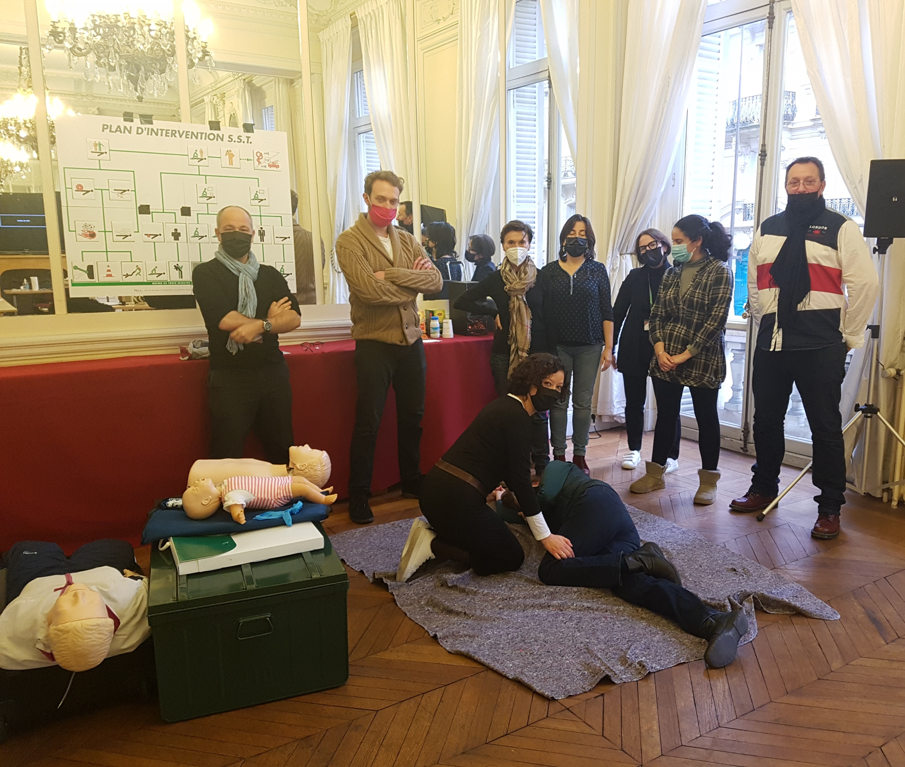
Occupational first-aid training course
December 2021

Slide 2
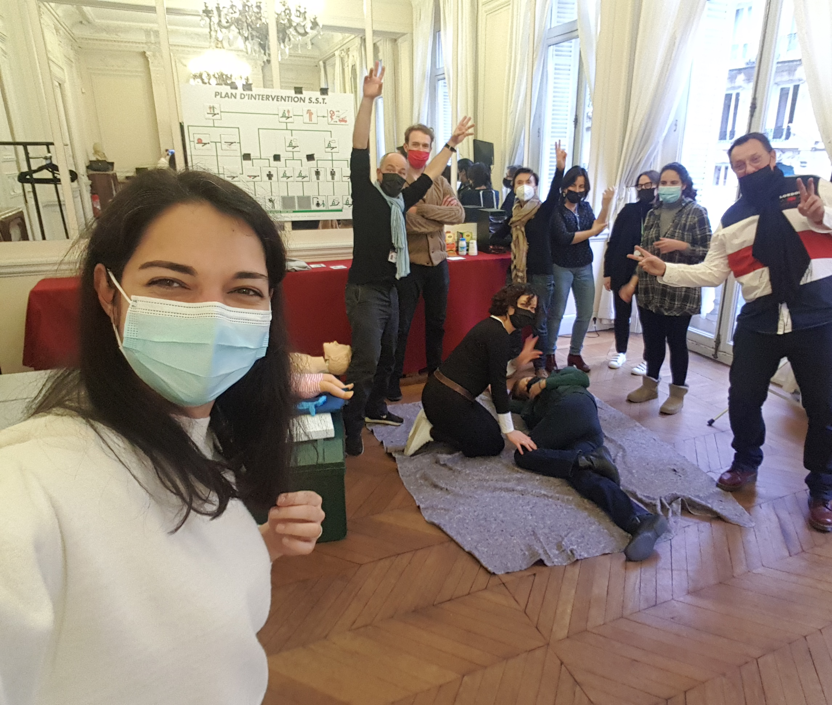
Questions
What number should you call in case of an emergency?
Is there a defibrillator at HQ?
What should you do if someone is choking or has fainted?
Ask one of us for the answers!
Alex Ginzburg, Christine Petit, Claudia Campos, Florent Taconnet, Ingrid Contreras, Leopoldo Stuardo, Lina Awada, Lucy Hogan, Mariana Marrana, Tamara Benicasa and Yael Farhi learned life-saving techniques earlier this month and can show you some first-aid basics.

